Slide 1



JAVA
PROJECT
WWW.SCALIVE.IN

Slide 2

What Is This Workshop All About?
STUDENTS LOVE OUR INITIATIVE AND IT’S RATING IS 4.8 STAR. THIS IS OUR HIGHEST RATED BATCH
6
WE HAVE DONE 8 PROJECTS TILL NOW IN THIS BATCH AND THIS IS OUR NINETH PROJECT
5
MORE THAN 5000 JAVA DEVLOPERS HAVE DONE THEIR FIIRST PROJECT WITH US
4
MAINLY AIMED TOWARDS IMPROVING PRACTICAL SKILLS OF OUR STUDENTS
3
3
STARTED IN JULY 2017
2
AN SCA INITIATIVE
1

Slide 3
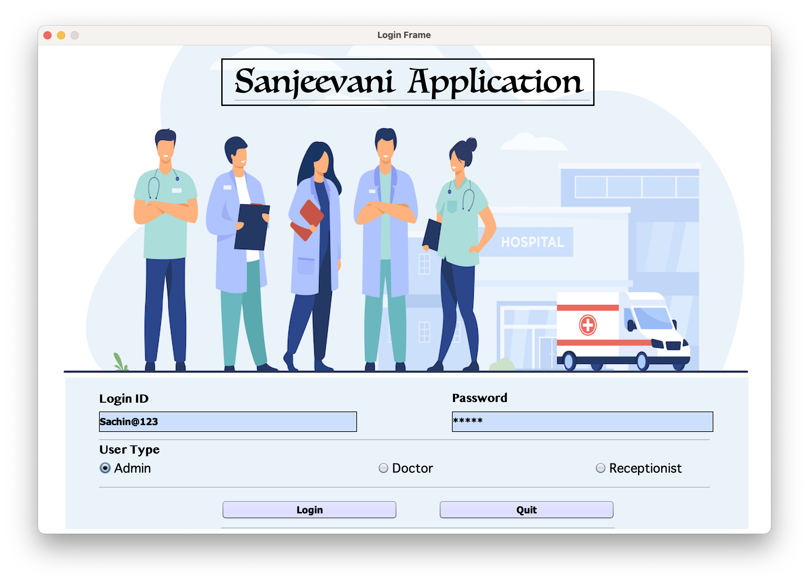
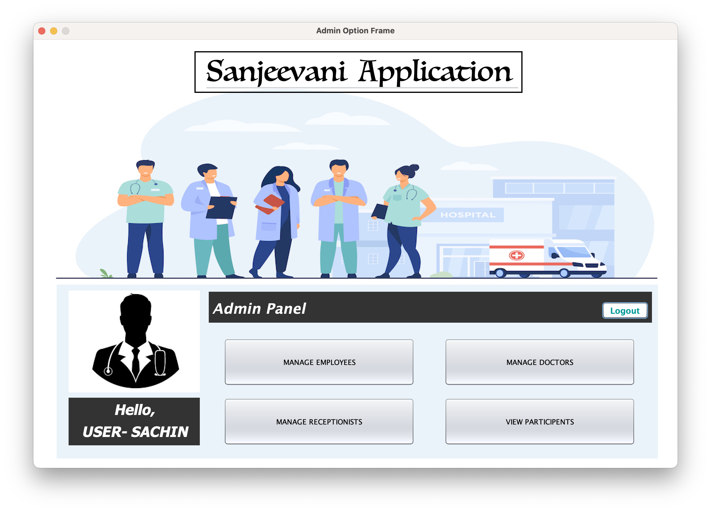
Our Project !!!
Sanjeevani Application
Key Feature: Sending and validating OTP via JAVA

Slide 4
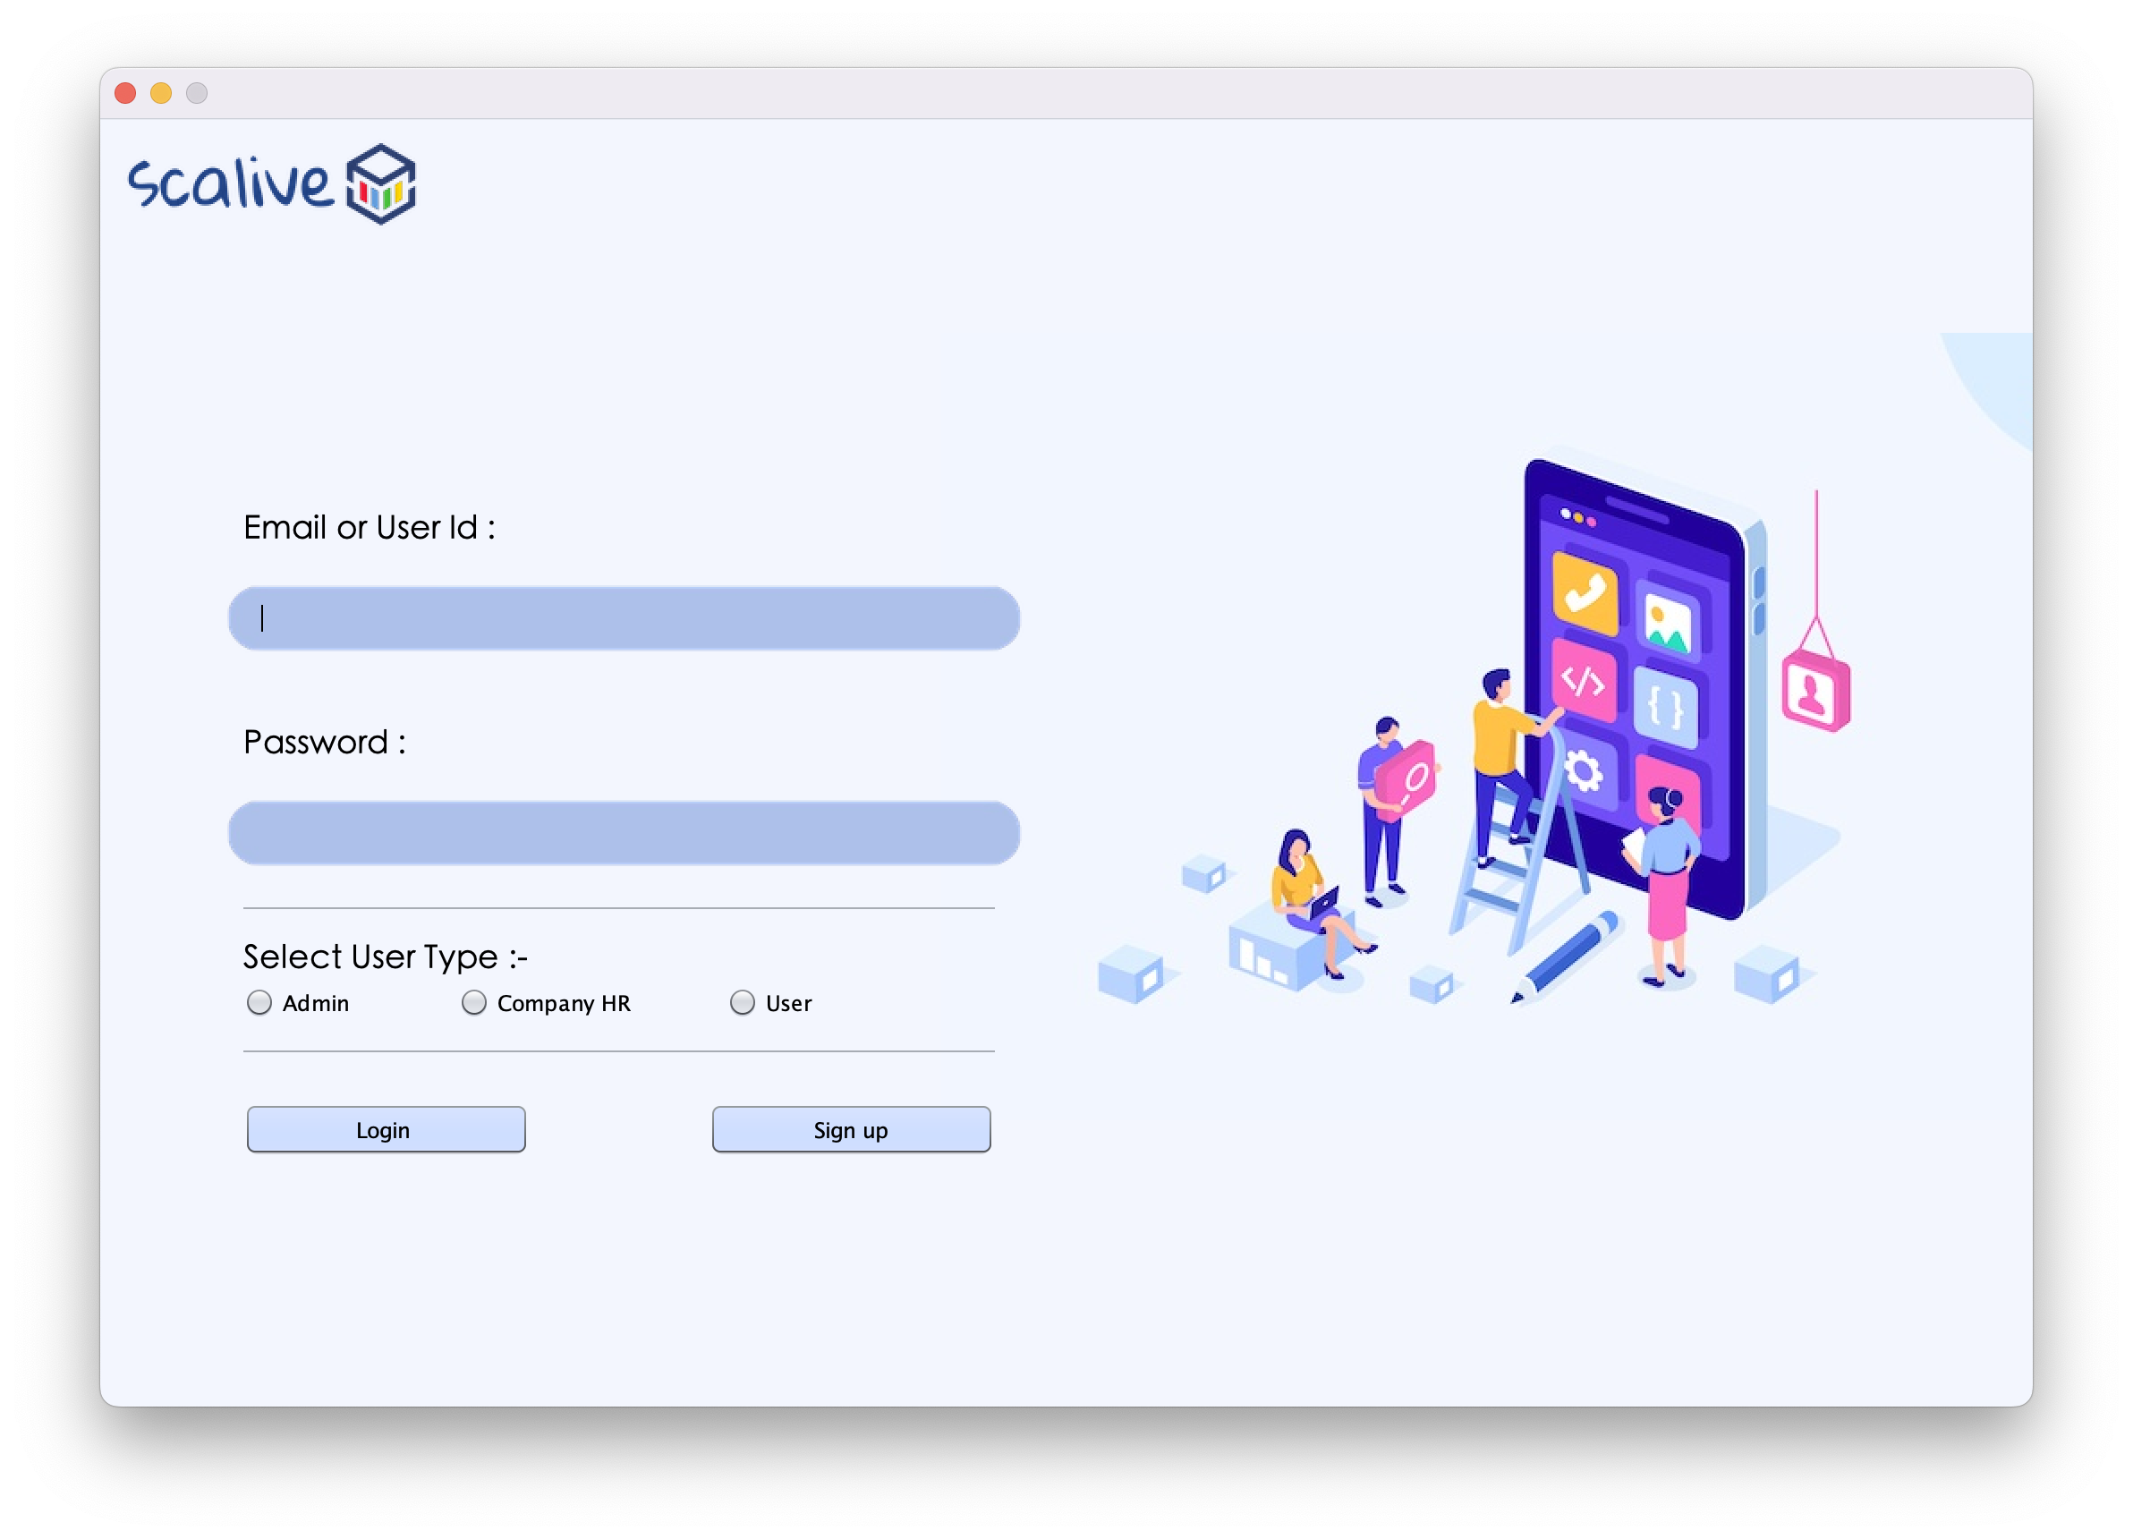
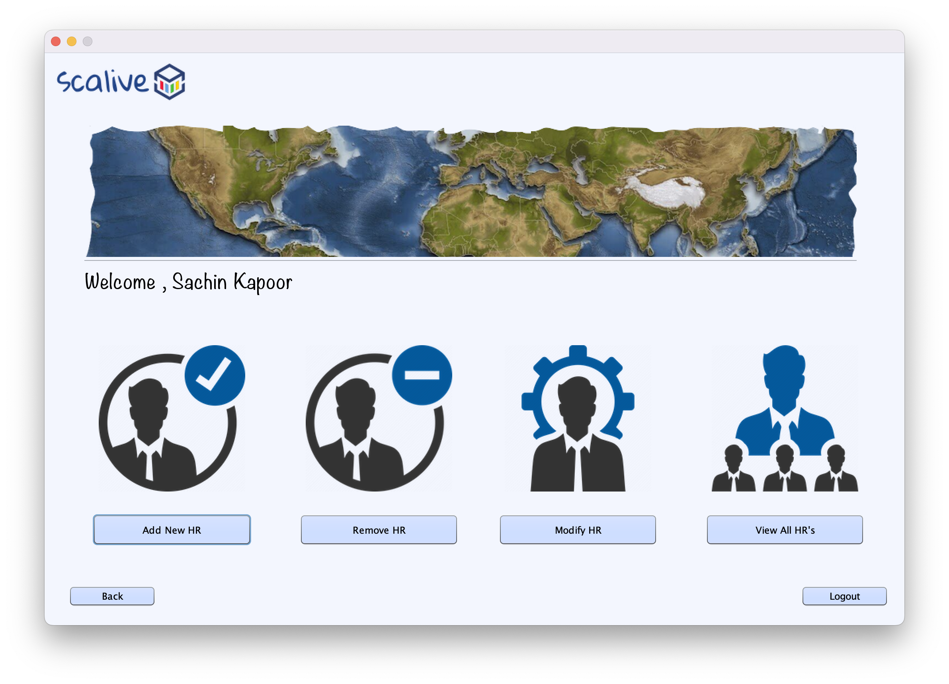
Our Project !!!
Training & Placement App
Key Feature: Using Cloud Based Database

Slide 5

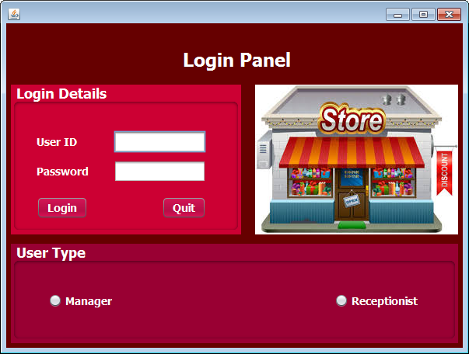

Our Project !!!
Mystic Mart App
Key Feature: Generating And Reading BARCODE Using Java

Slide 6
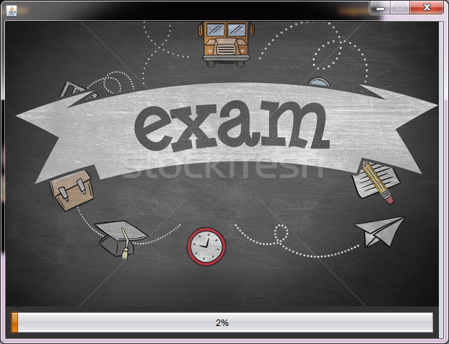
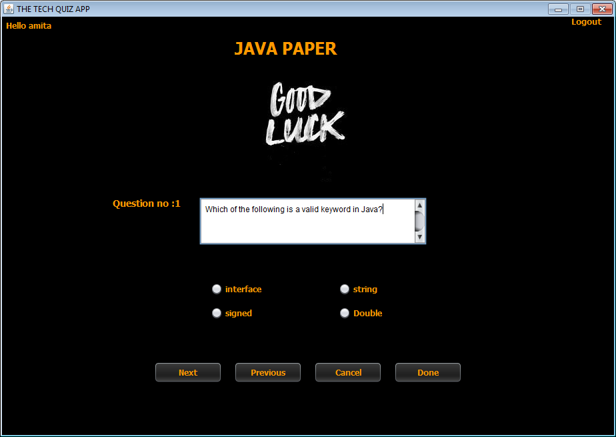
Our Project !!!
TechQuiz App
Key Feature: Applying Data Structures Like HashTable

Slide 7


KEY HIGHLIGHTS
DEVELOP A PROJECT
LEARN INDUSTRY
STANDARD
ON THE SPOT PRACTICALS
ASSIGNMENTS
CERTIFICATE

Slide 8



PRE REQUISITES
Basics Java Concepts
Exception Handling
String
Encapsulation
Inheritance
Polymorphism
Interfaces
Exception Handling Basics
Checked And Unchecked Exception
String
StringBuffer

Slide 9

REQUIRED SOFTWARE
01
02
03
JDK 8
NetBeans 8.2
Oracle 10g/11g

Slide 10







WHAT WE WILL LEARN?
Java’s
Collection API
JDBC
For connecting to the Database
GUI
Graphic User
Interface
API Integration,
Mail Sending,
Food API
Password Encryption
Multithreading For Splash Screen
of the Project

Slide 11
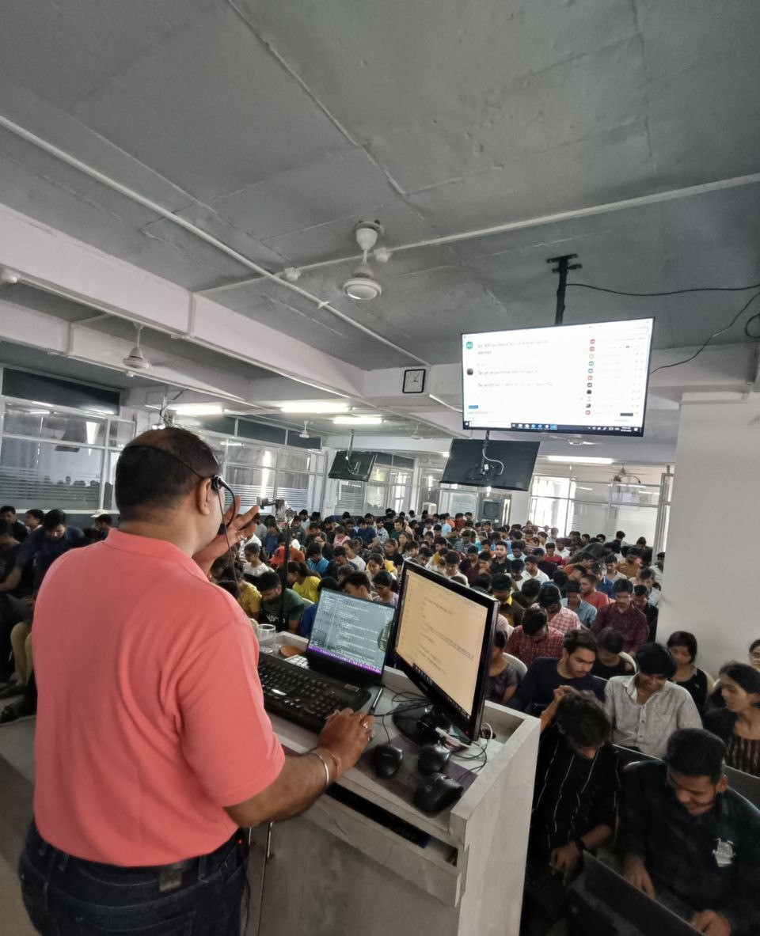

Ready for the Project
START

Slide 12



JAVA
YumXpress App
www.yumxpress.in

Slide 13
Introduction
Complete Food Management Solution
Seamlessly Connect Sellers, Staff, and Customers
Explore the Power of Streamlined Food Operations

Slide 14
The Trio of Roles
1
Seller Option
Effortlessly Manage Menu and Orders
Enhance Order Processing Efficiency
2
Staff Option
Smooth Order Handling and Delivery
Collaborate Seamlessly with Sellers and Customers
3
Customer Option
Intuitive Ordering Interface
Real-time Order Tracking and Personalized Experience

Slide 15

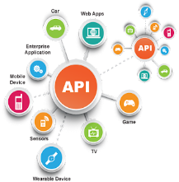

Key Features
1
Mail API
Instant Communication with Users
Prompt Order Confirmations and Updates
2
Food API
Diverse Food Selection at Your Fingertips
Accurate Food Information and Appetizing Images
3
Send Receipt
Automated Receipt Delivery to Customers
Enhance Customer Satisfaction and Trust

Slide 16
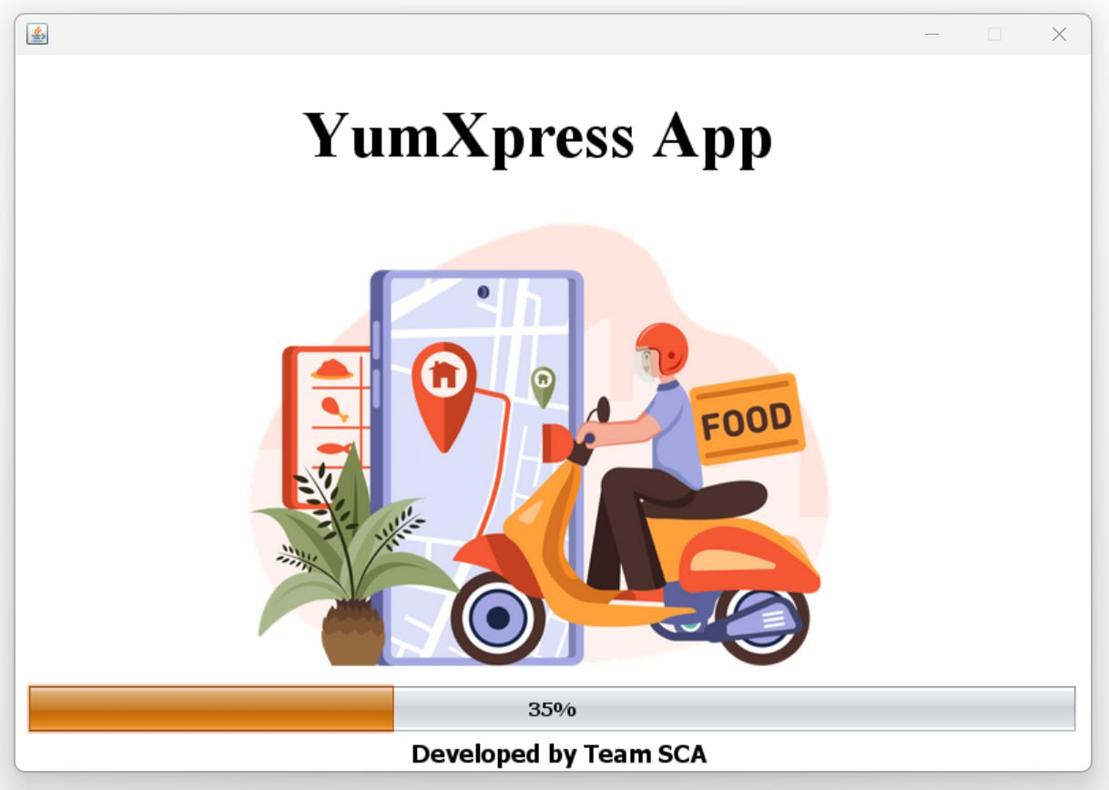
SCREENSHOTS

Slide 17
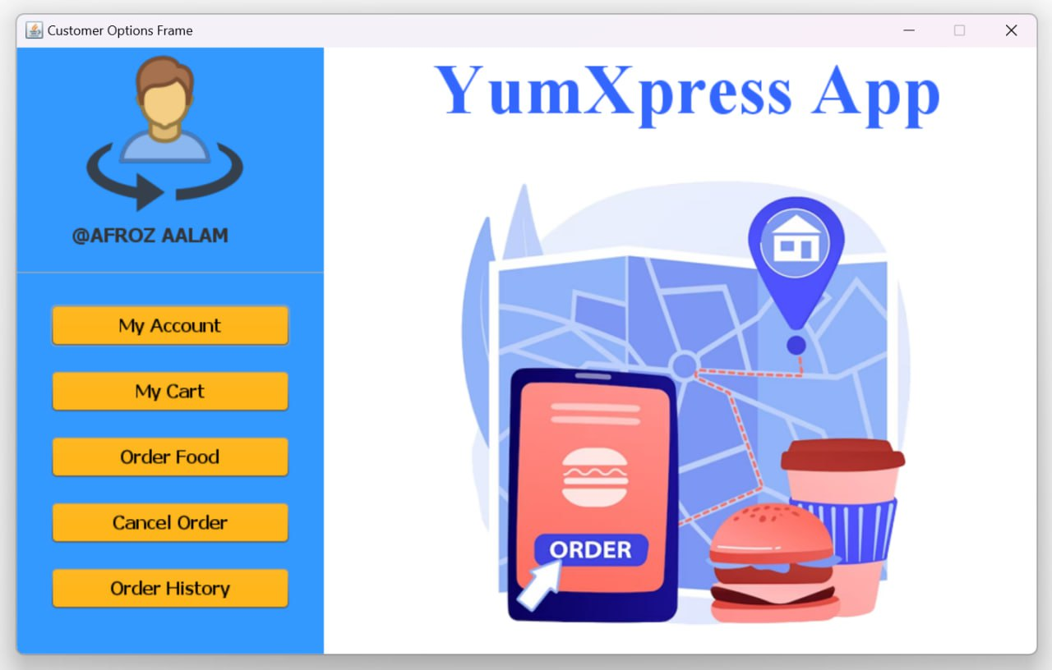
SCREENSHOTS

Slide 18
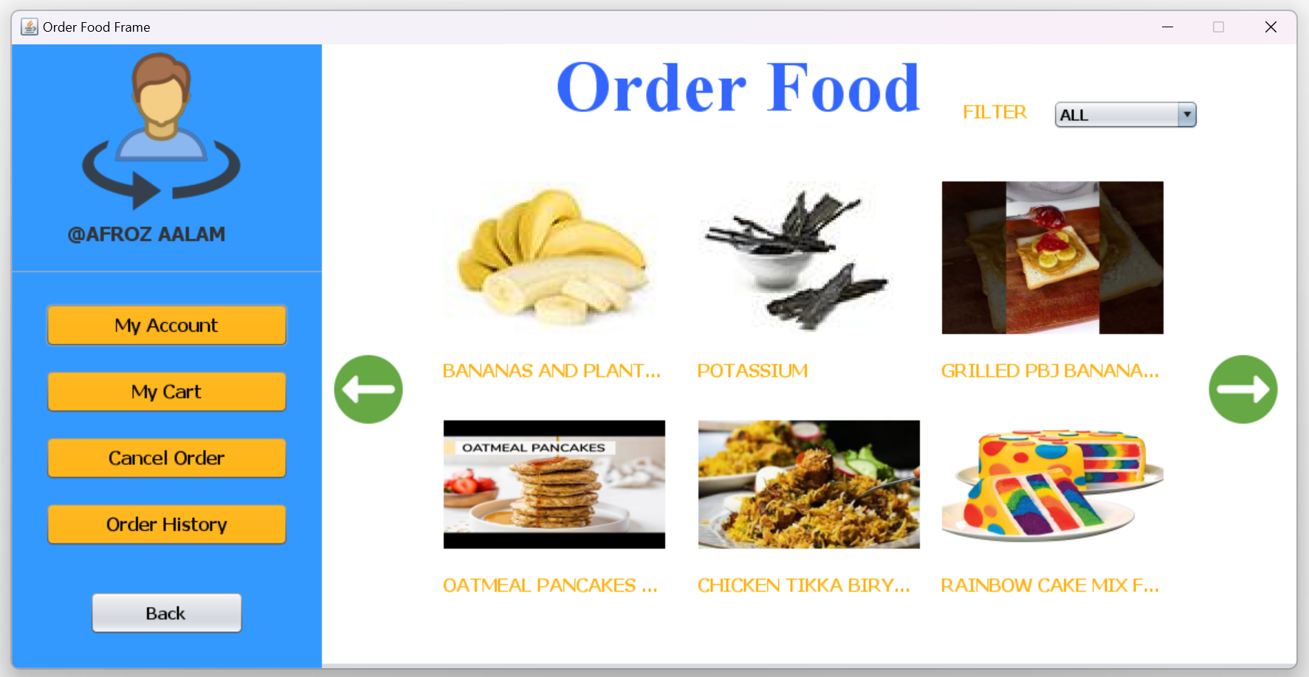
SCREENSHOTS

Slide 19
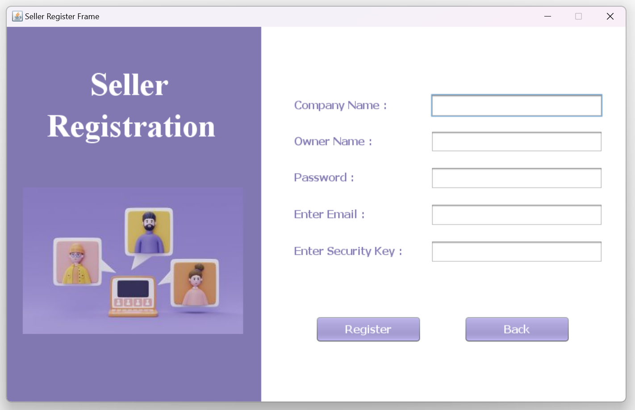
SCREENSHOTS

Slide 20
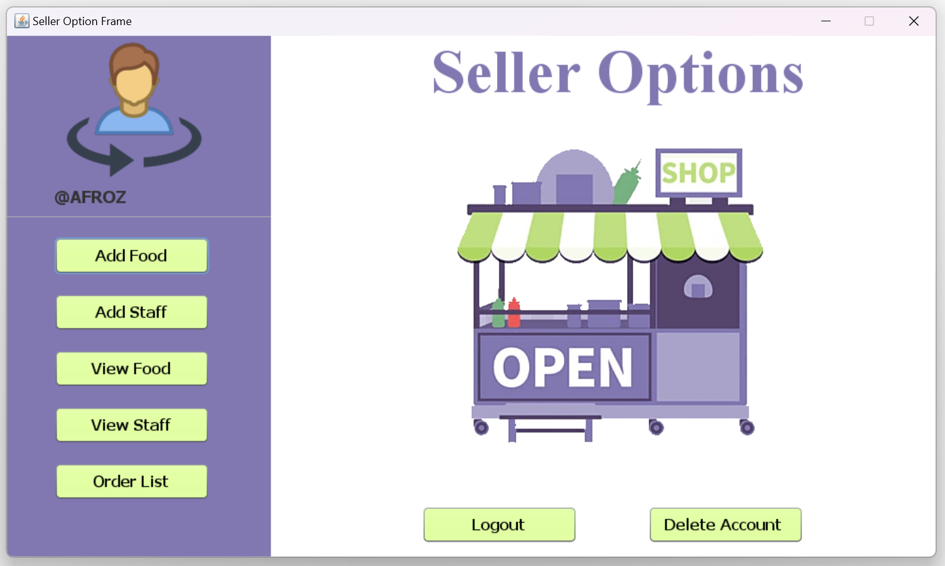
SCREENSHOTS

Slide 21
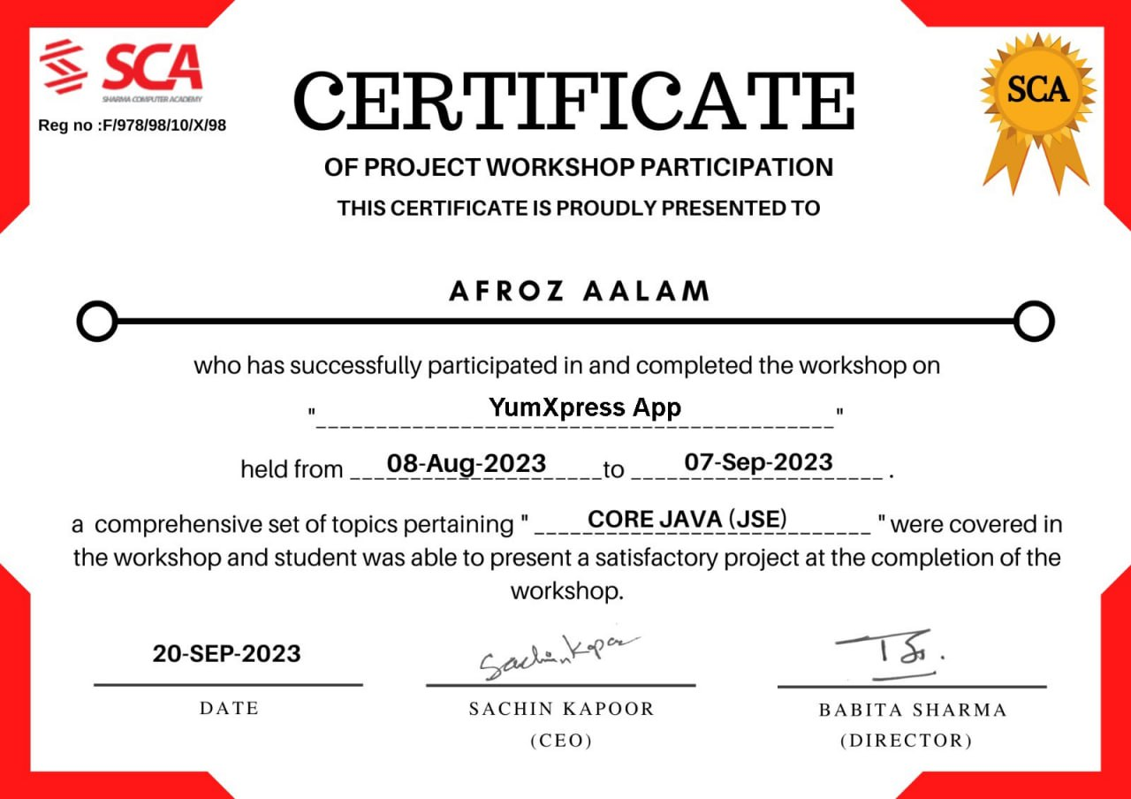
CERTIFICATE

Slide 22
Project Completion Certificate Condition
90% Attendance
Satisfactory project performance
Timely completion of Assignments

Slide 23

BATCH SCHEDULE
Tuesday, Thursday and Saturday
( Sometimes off depending on progress)
Timing: 8:15 PM
Topics: Packages & Collection
First Class: Thursday , 10th Aug , 8:15 PM

Slide 24




FACULTIES
Sachin Kapoor
Paramjeet Saini
Seema Joshi
Educator, Corporate Trainer and CEO
Educator, Corporate Trainer and Manager
Educator, Corporate Trainer and Co-Manager

Slide 25


